Slide 1
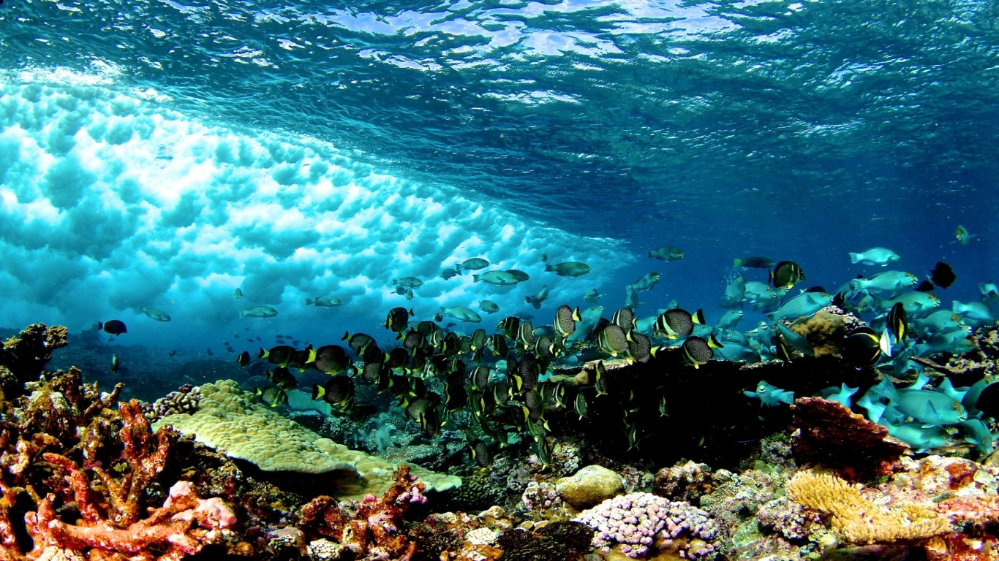
CORAL SPECIES IDENTIFIER
Danielle Lamb

Slide 2
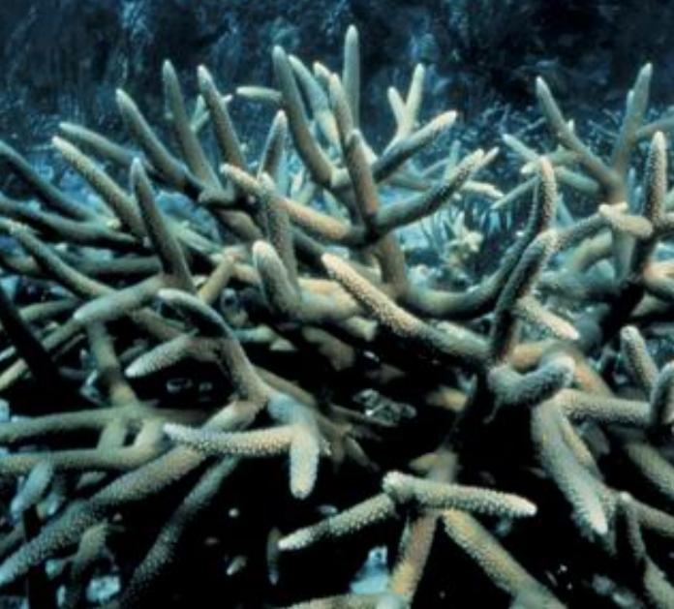
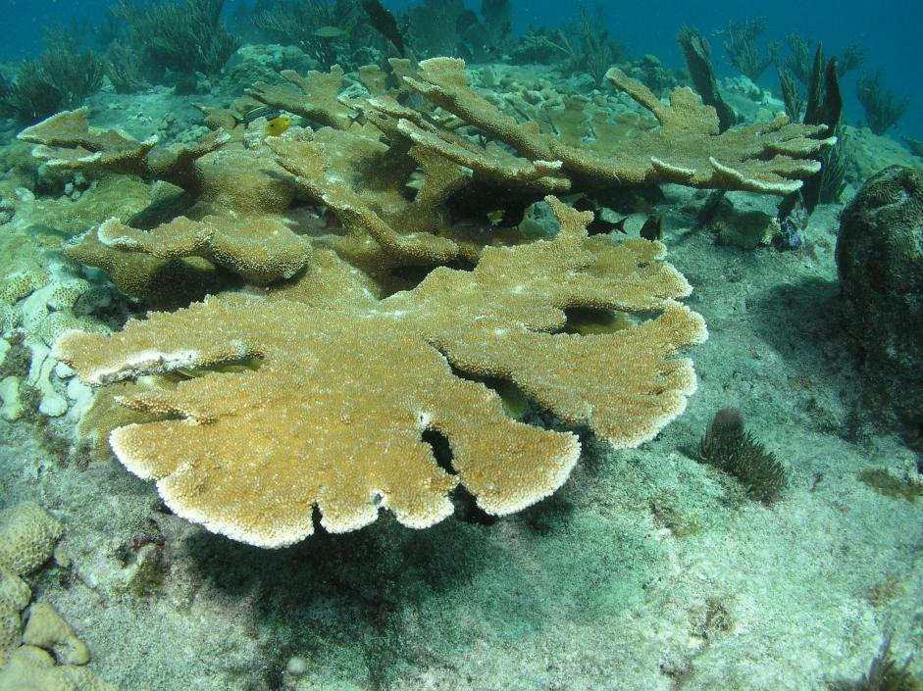
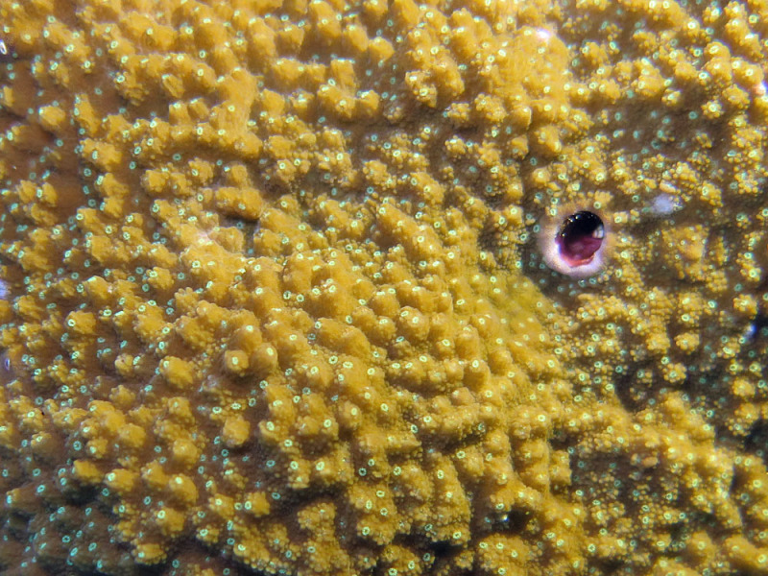
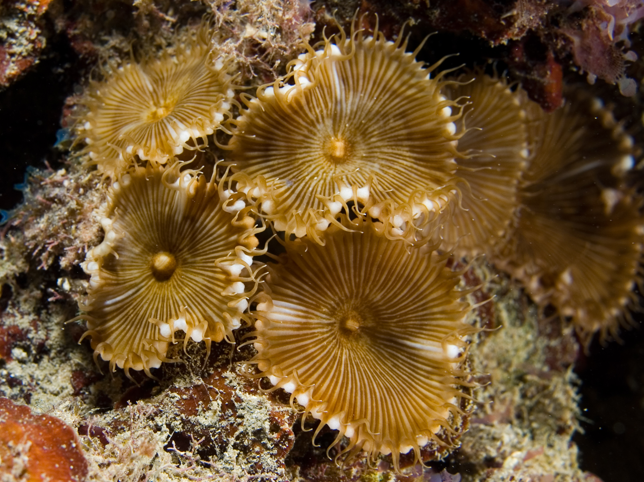
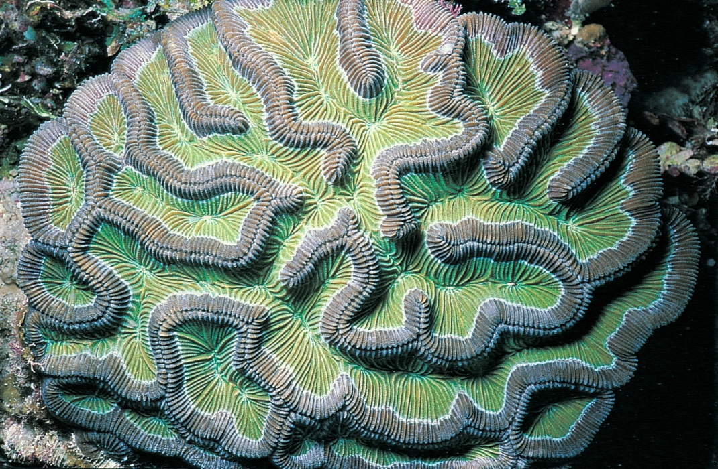
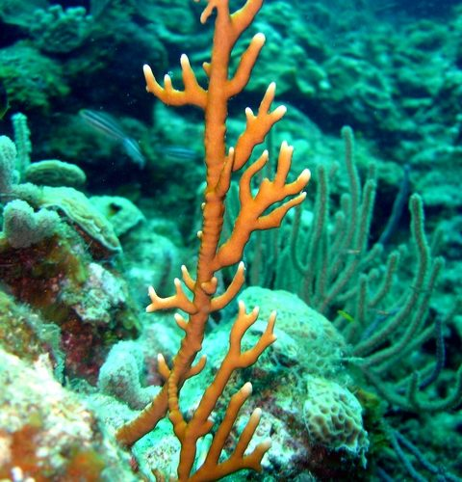
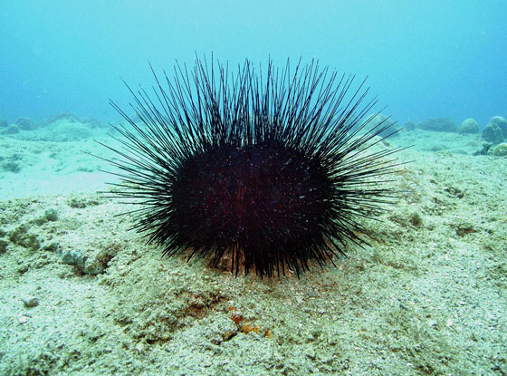
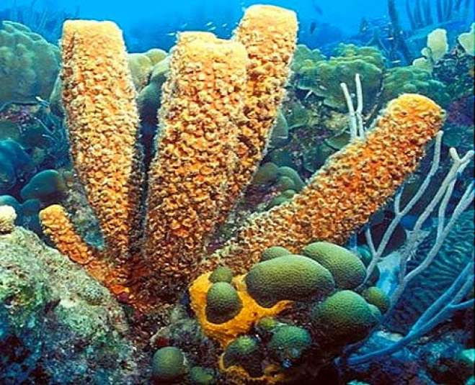
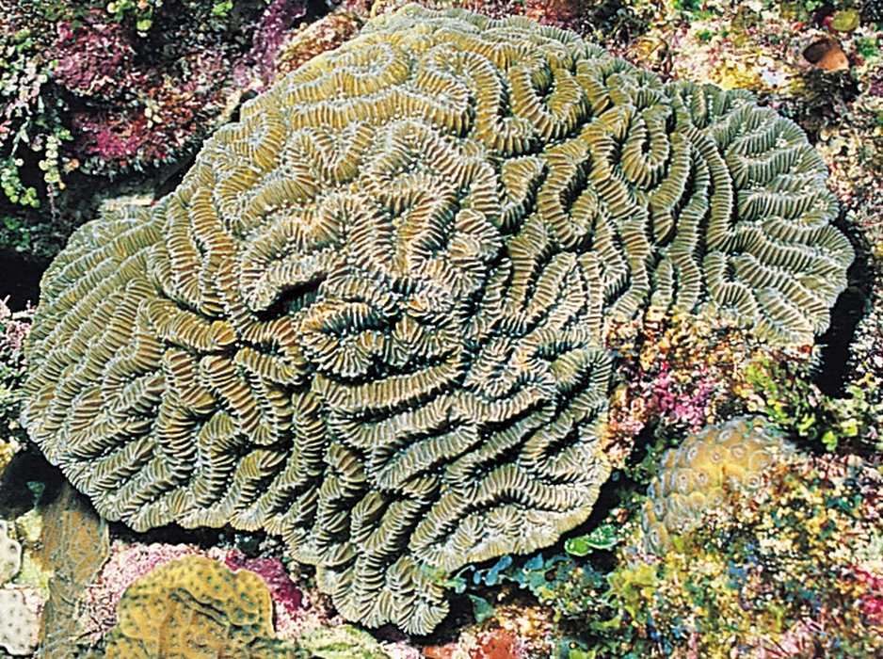
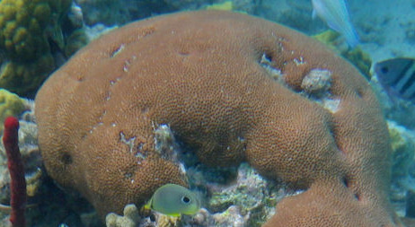
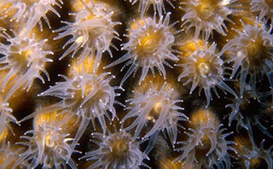

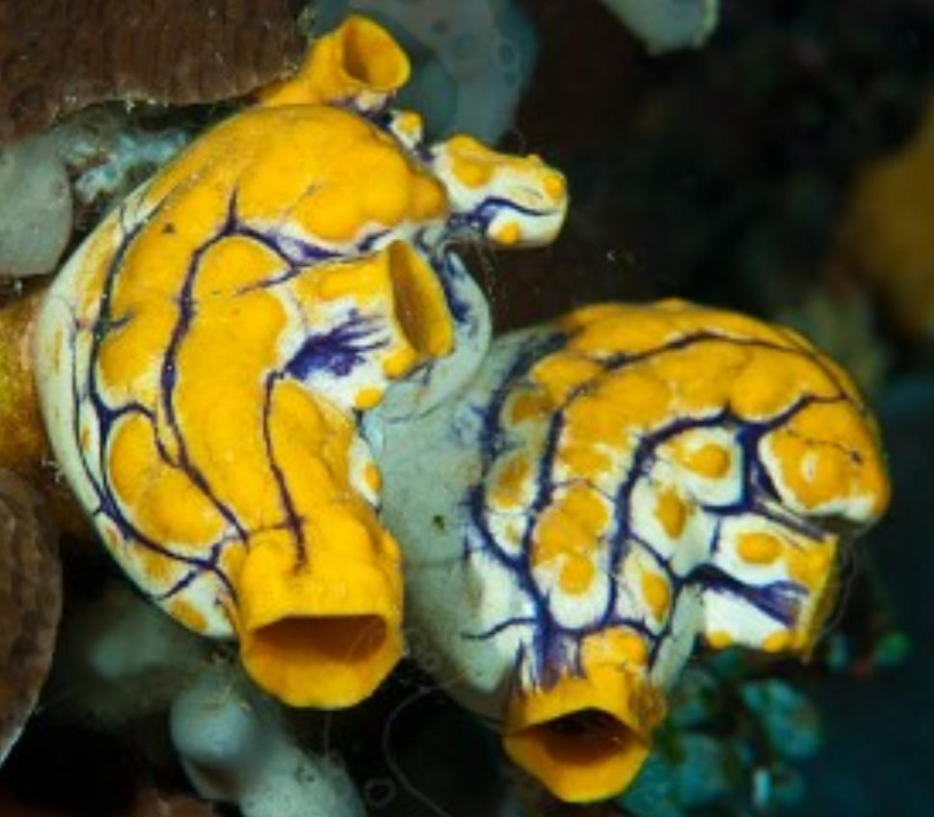
BACKGROUND
With about six thousand species of coral in the ocean, knowing how to identify the differences between each type is important.
Just like on land, seeing certain species is an indication of great reef health, others indicate it is a newer reef or a dying reef.
If corals are in the process of bleaching, meaning the coral is losing its important photosynthesizing plankton, it is a large indication that there was a change in the environment, such as the water quality.
Before long, the fish and other species that create the amazing diversity of reef will also leave the reef.
Notes:
Coral reefs are a good indication for overall ocean health. They are said to be the rainforests of the ocean, sustaining a huge amount of diversity within them. While the animals themselves are diverse, they are also home to many species of fish, invertebrates, and crustations. Globally, there are about 6000 species of coral, many of which are similar in appearance. Certain emergence of coral species can be indicative to a healthy mature reef, while others indicate there could be a decline in health. As waters warm from climate change and become more acidic due to ocean acidification, corals struggle to survive. If the coral in a reef dies, the rest of the ecosystem breaks down and the fish, invertebrates, and crustations that call that area home will leave to find a more sustainable area to live.

Slide 3
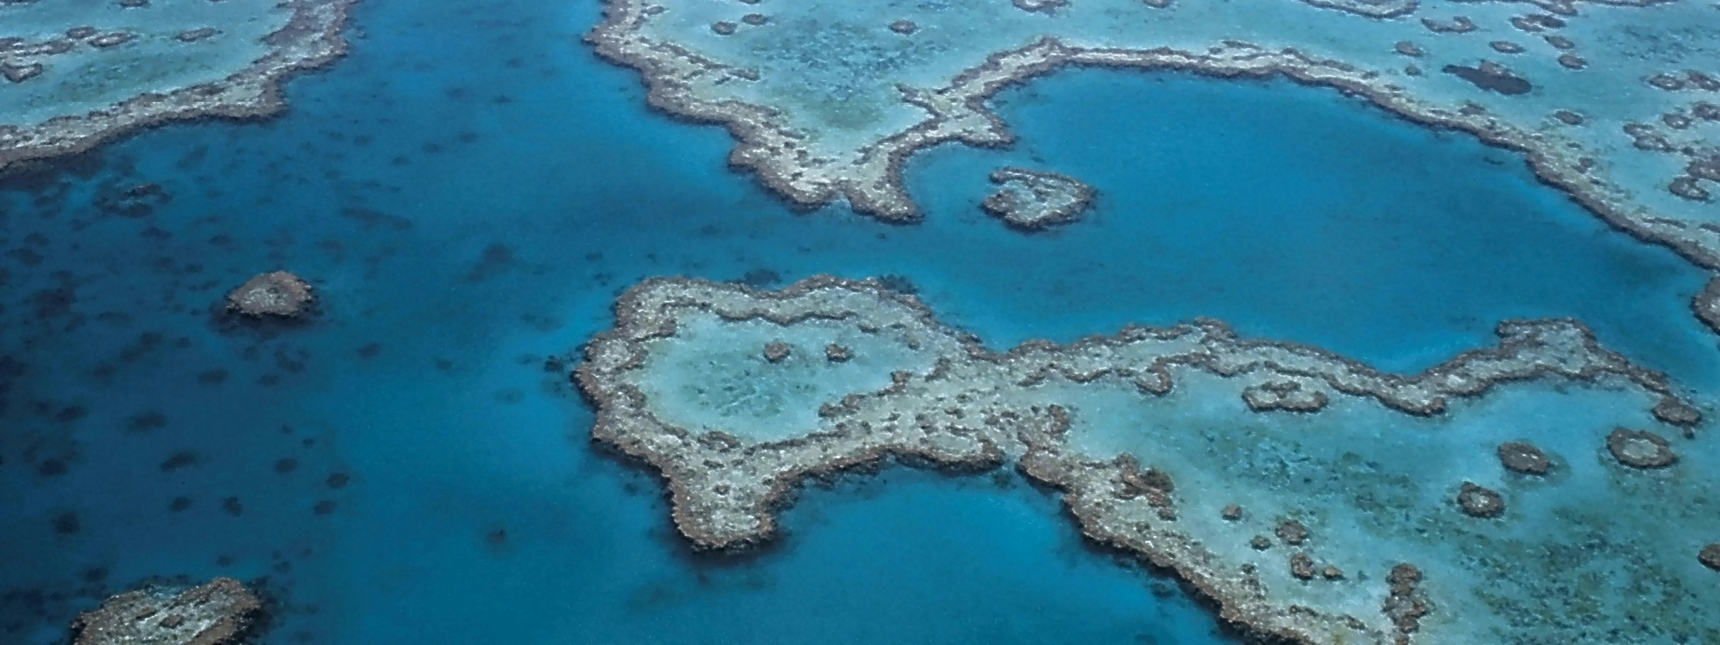
PRIMARY GOALS
Create Convolutional Neural Networks that can identify species of coral by entire structure or texture images

Slide 4
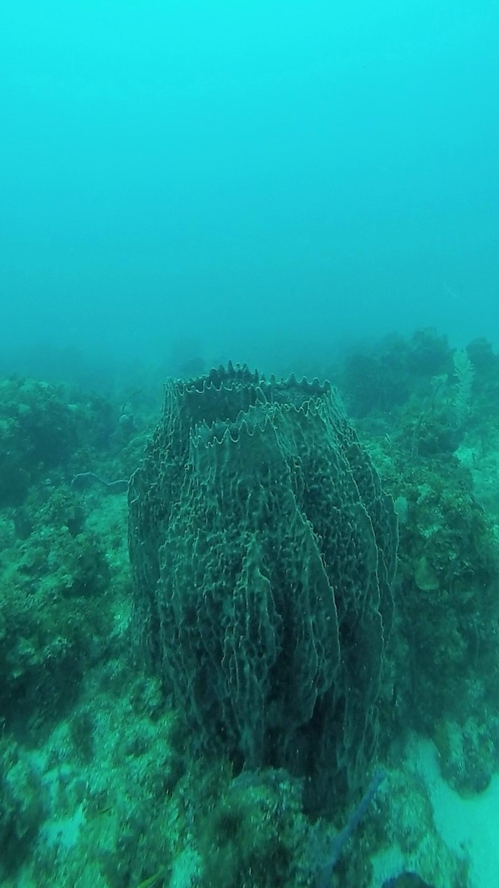
IMPORTANCE
Being able to quickly identify the coral species using deep learning will allow for a more efficient identification of potential problems on reefs that can be rectified quicker than if the species identification was done manually.
Notes:
With the largest reef being approximately 133,000 square miles, it can be difficult to accurately identify the majority of species on a reef. If one were to sort through video and images to manually identify these species, it could take months. Having a program that can do this automatically cuts down on the human time needed to do this process and allows them to be able to complete other parts of the research project. This would allow the research to be completed faster and if steps were required to intervene to save the reef, those steps can be made much sooner than if it were all done by hand. This could be the different between a reef being saved and a reef being lost.

Slide 5
AREAS OF FOCUS
Separating Texture Images from Structure Images
Texture Image Identification and Structure Image Identification
A convolutional neural network will determine if the incoming image is a texture image or a structural image
Corals can look very different when looking at their structure versus the coral polyps
This first stage allows the machine to separate the images to then be fed into a second stage neural network based on what type of image it is
This second stage will have images separated from the first neural network into its appropriate second neural network
By using the second stage networks, the species of coral can be identified quickly and easily for researchers

Slide 6
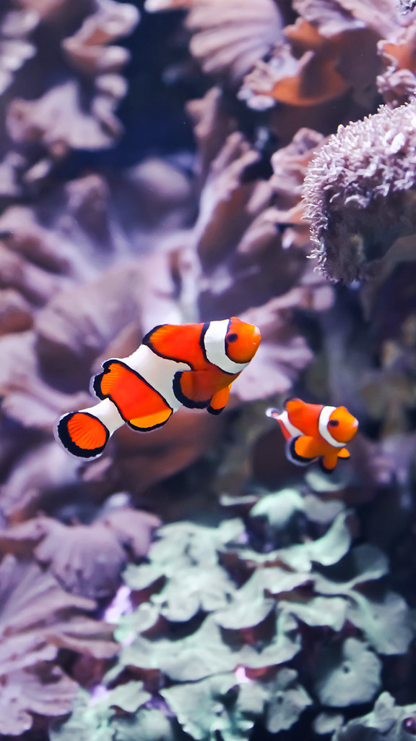
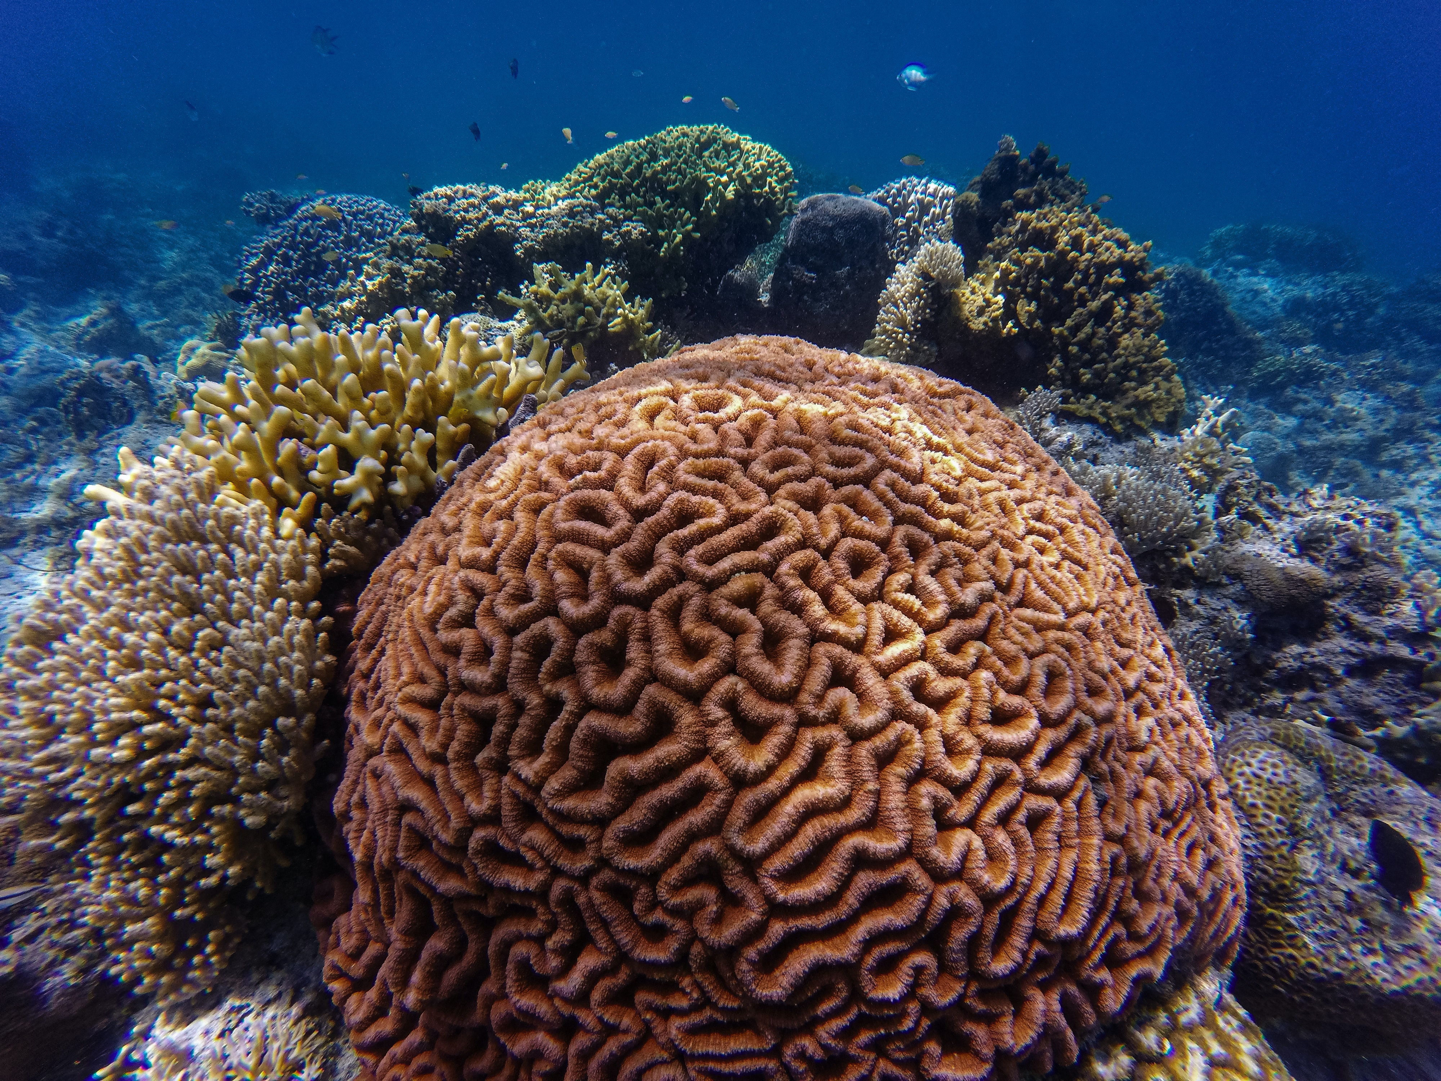
“There’s nothing wrong with enjoying looking at the surface of the ocean itself, except that when you finally see what goes on underwater, you realize you’ve been missing the whole point of the ocean.”
DAVE BARRY
This Photo by Unknown Author is licensed under CC BY-SA

Slide 7
NEURAL NETWORK RESULTS

Slide 8
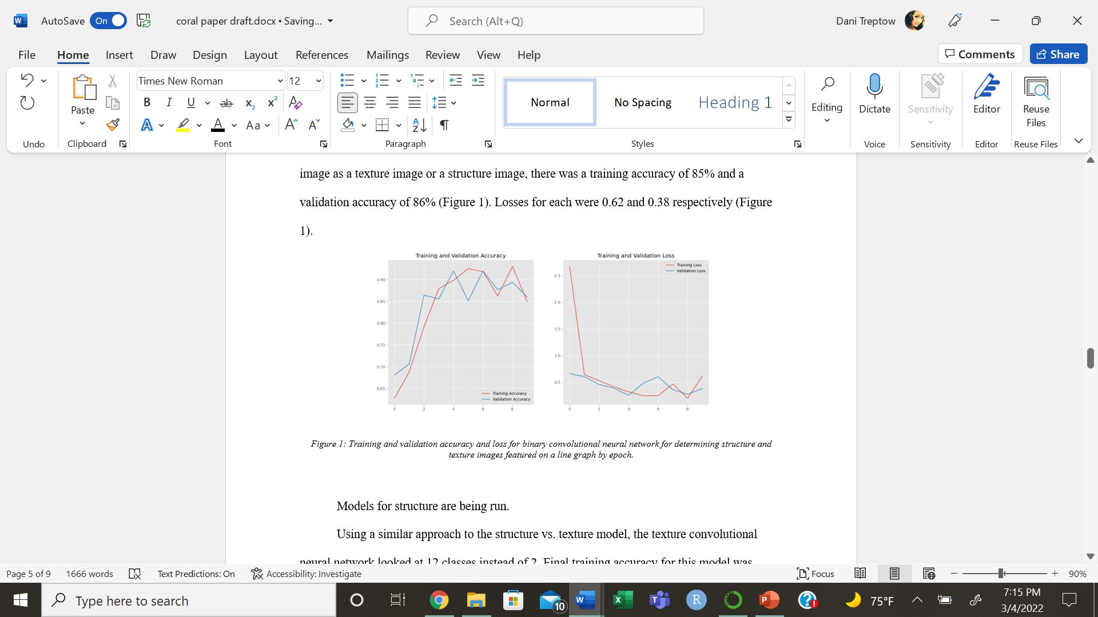
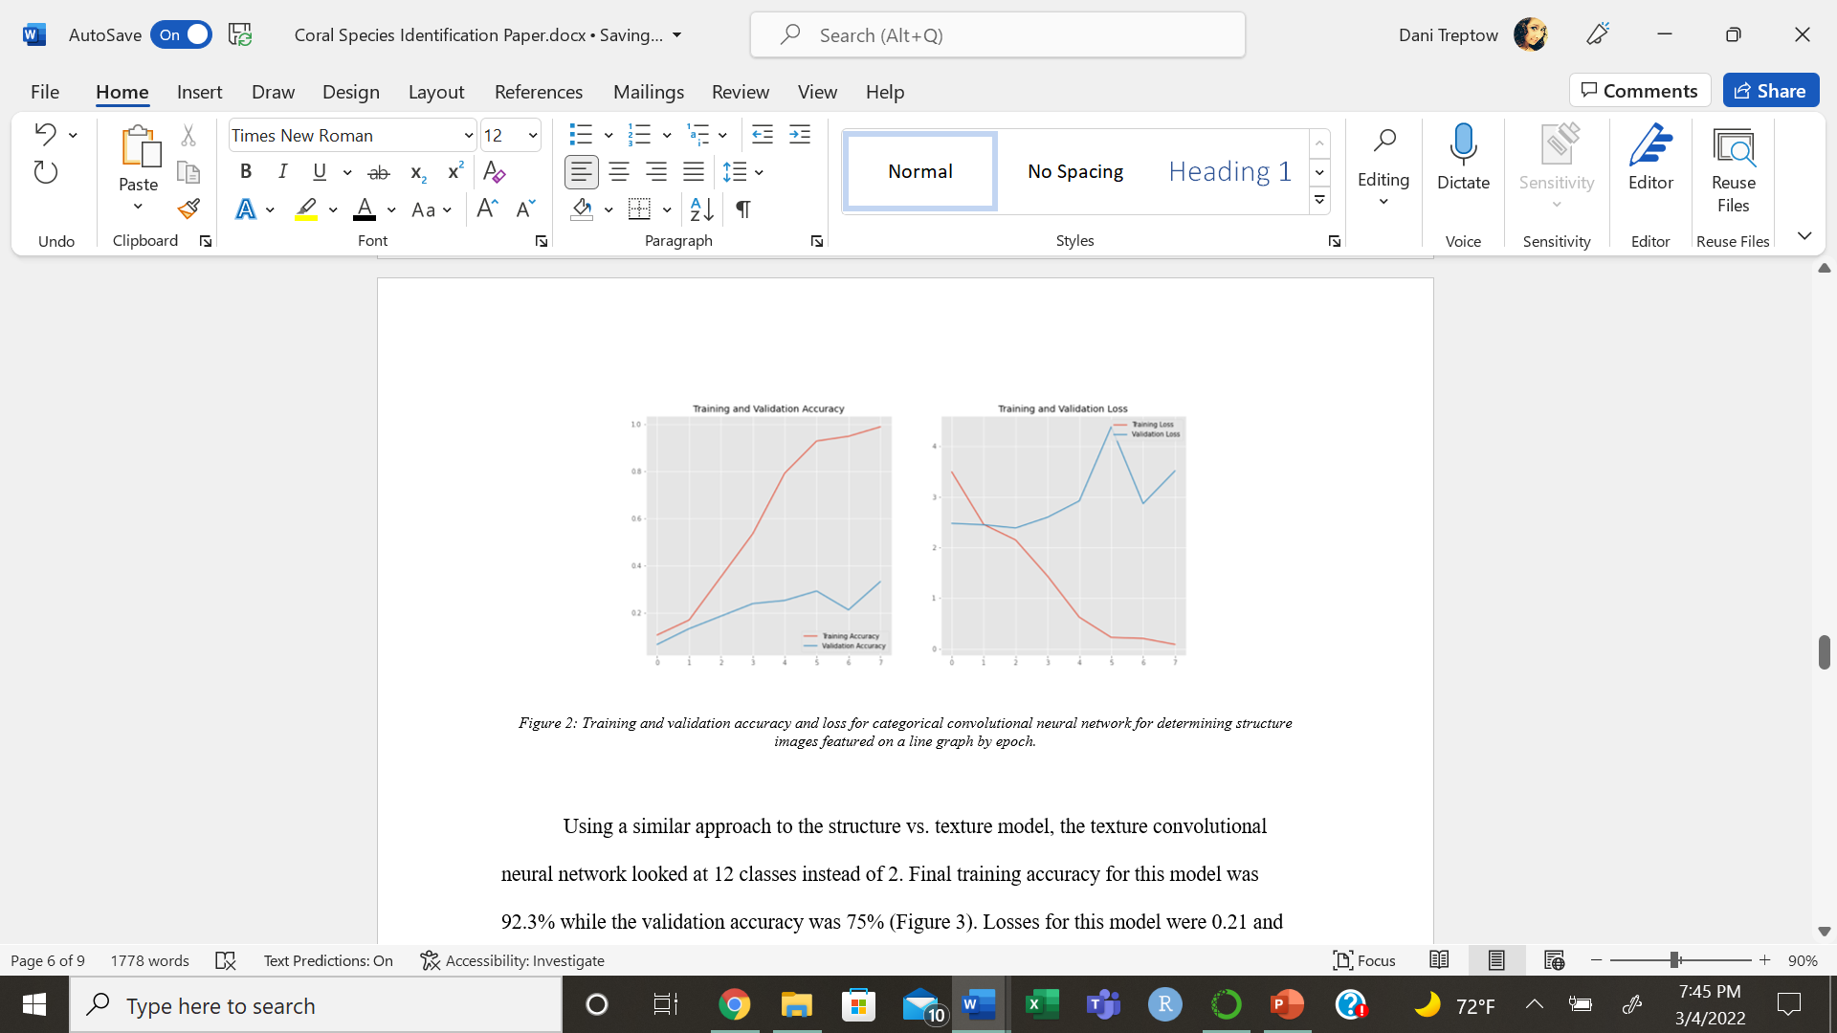
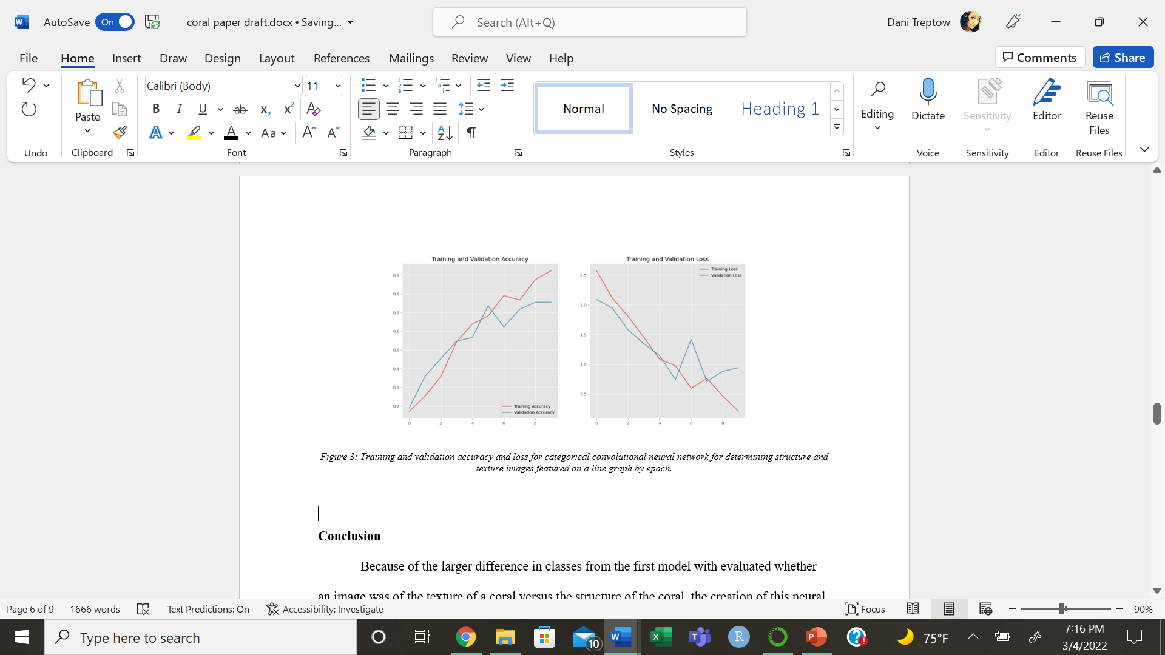

Slide 9
RESULTING NETWORKS
Structure vs. Texture
Structure
Texture
Binary convolutional neural network
5 layers of convolution and pooling
Dense layer of 512
Output layer with sidmoid activation and 2 options
Adam optimizer with learning rate 0.001
Fit with 10 epochs
Convolutional neural network
2 layers of convolution and pooling
Dropout layer of 0.2
Dense layer of 416 with relu activation
Adam optimizer with learning rate of 0.001
Fit with batch size of 12 and 8 epochs
Convolutional neural network
3 layers of convolution and pooling
Dropout layer of 0.8
Dense layer of 512 with relu activation
Softmax output layer with 12 options
Adam optimizer
Fit with batch size 10 and 10 epochs

Slide 10
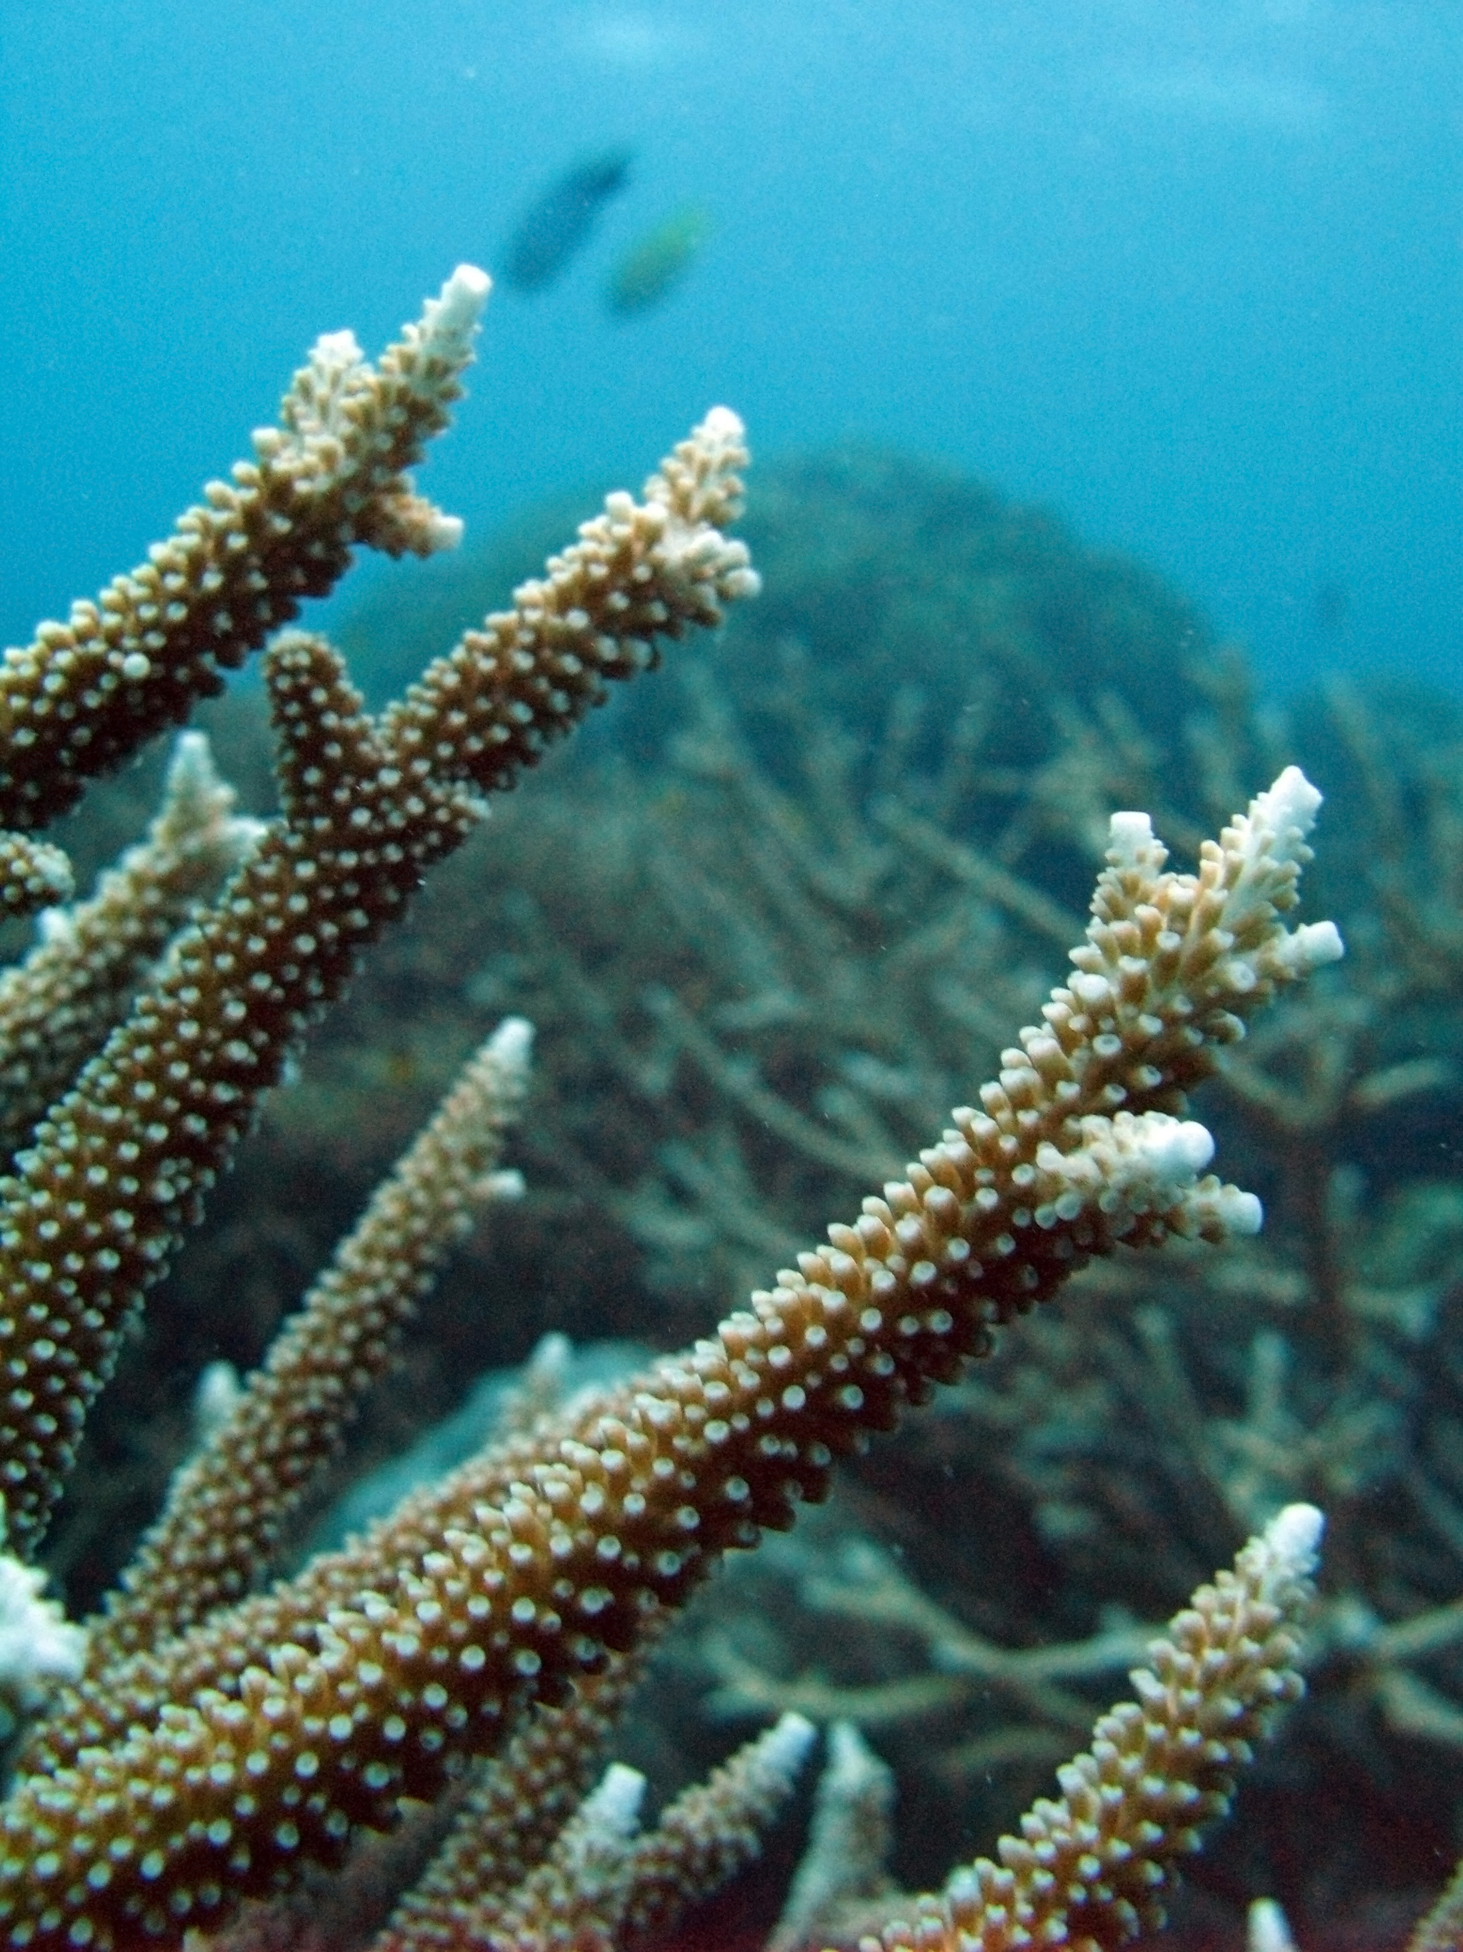
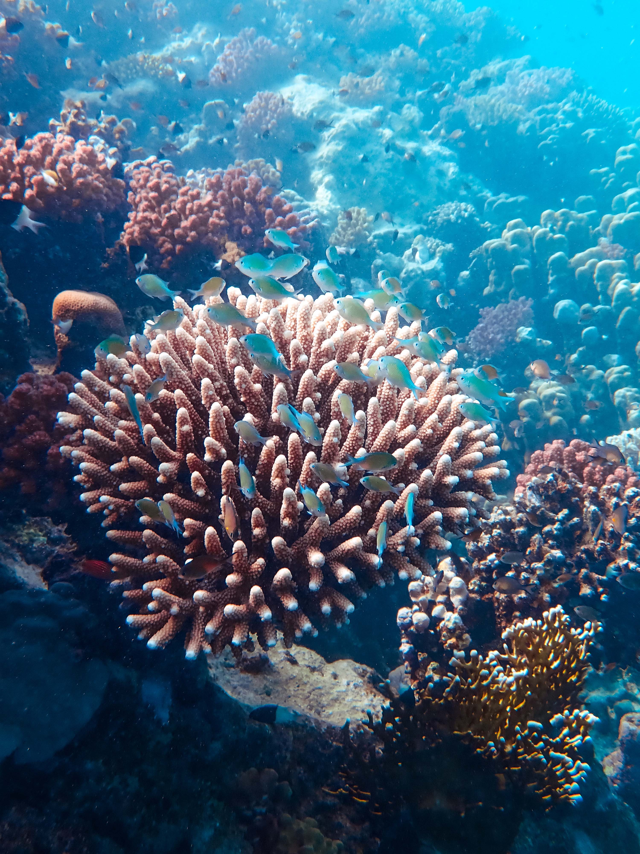
SUMMARY
Issues such as climate change and ocean acidification are causing coastal ocean waters to be not as suitable for coral reefs than in the past. By giving researchers a quick and efficient way to determine which species of corals are on their reefs and allows for a quicker turn to action if negative health impacts are seen on the reefs. Because of this, changes can be made quicker so that more coral reef ecosystems can be saved from extinction.
This Photo by Unknown Author is licensed under CC BY

Slide 11
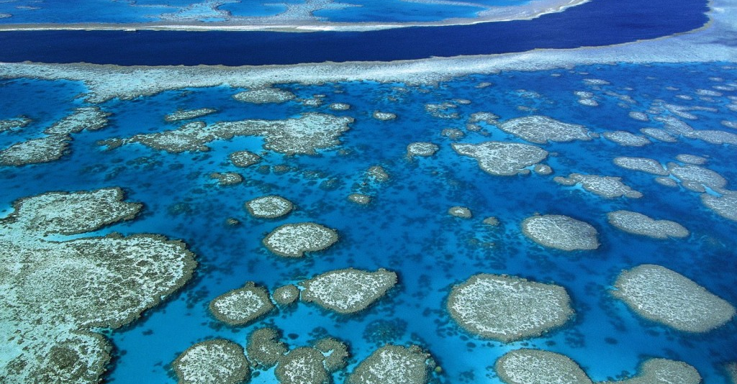
THANK YOU
Danielle Lamb
danielletlamb@gmail.com
This Photo by Unknown Author is licensed under CC BY-ND

